Slide 1
RFM model
File created on: 6/26/2022 12:55:34 PM

Slide 2
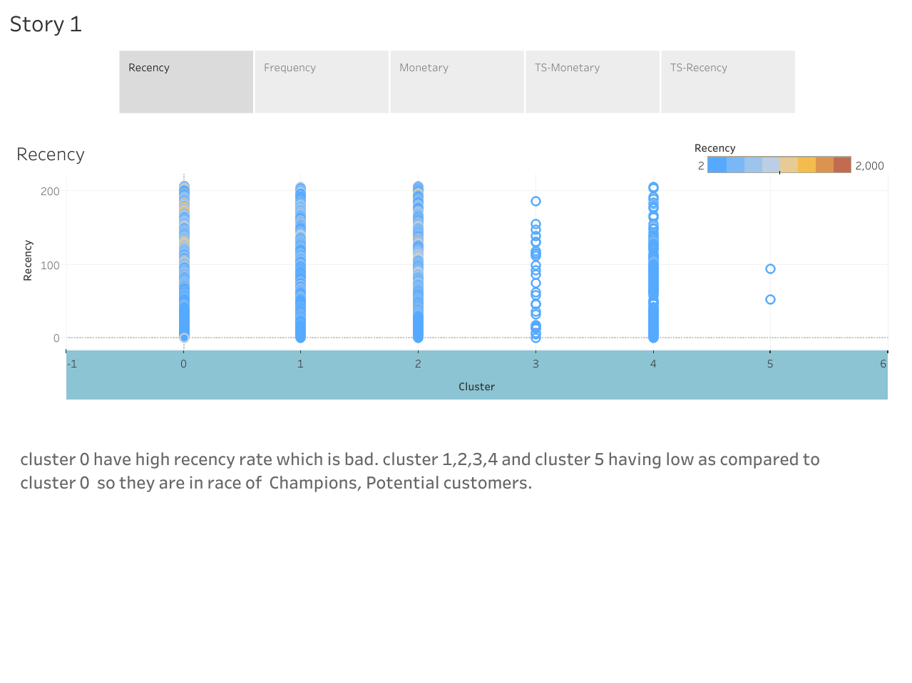

Slide 3
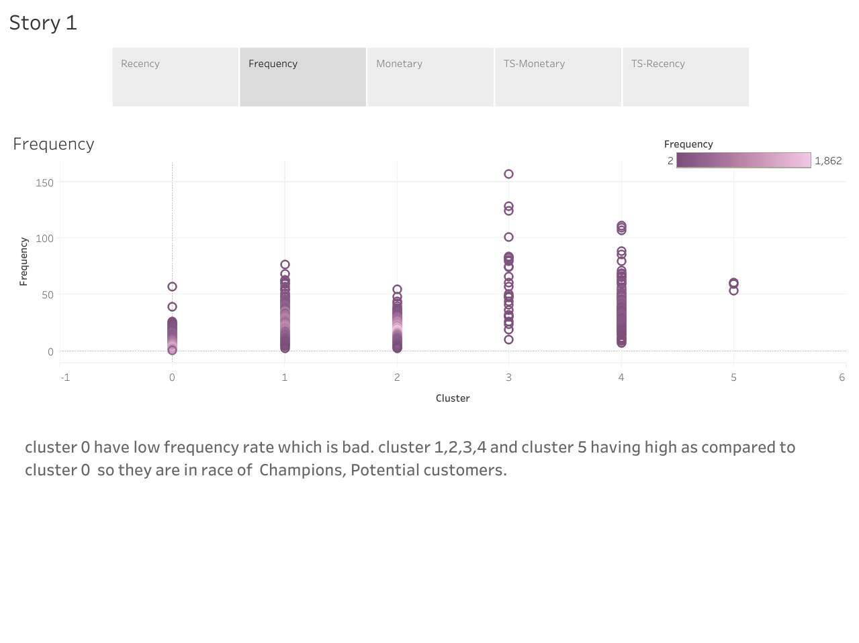

Slide 4
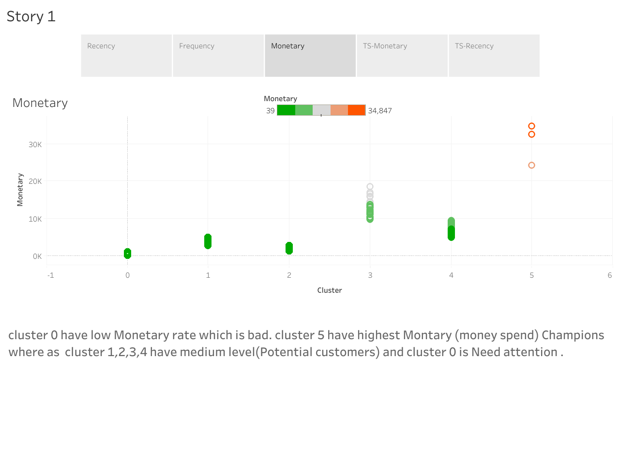

Slide 5
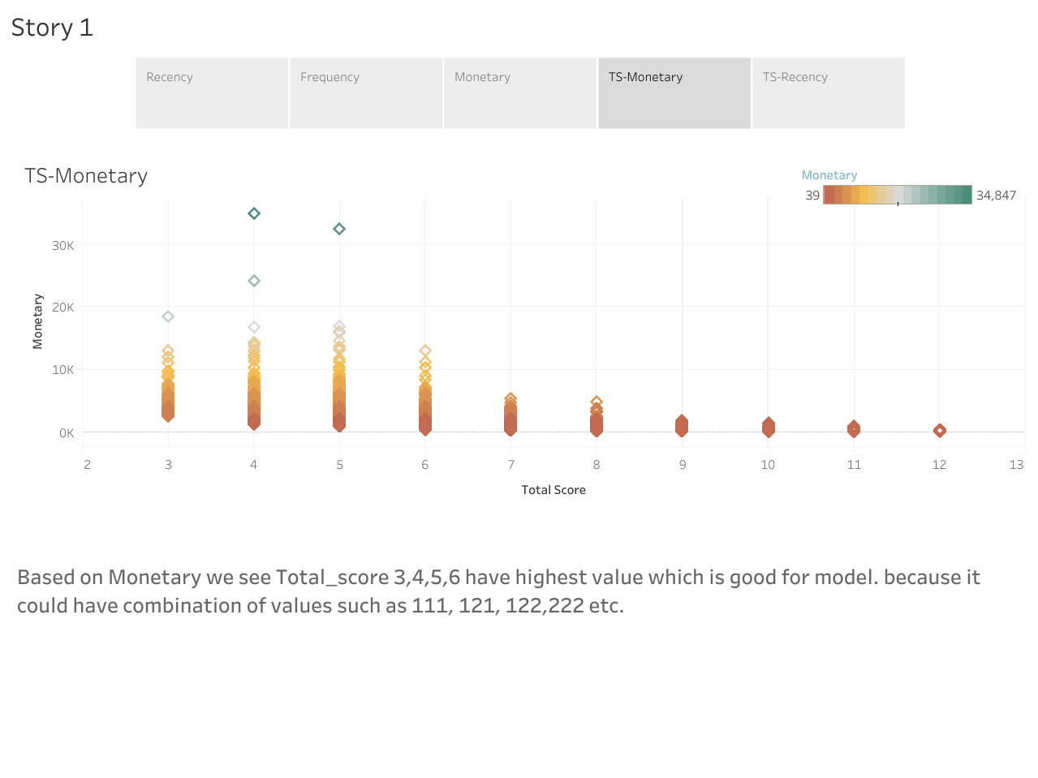

Slide 6
